Slide 1
StatwayTM and QuantwayTM: Networked Improvement Communities in Developmental Mathematics
Julie M. Phelps, AMATYC External Pathways Liaison
Roberta Brown, Valencia Statway™ Mathematics Faculty and
Productive Persistence

Slide 2
The Problem: Developmental Math
60% of community college students | 60% of CC students taking the placement exam need at least 1 remedial course
3-5 additional courses | The remedial college math path can be 3-5 courses
> | More students drop out between courses than from an actual class
1 remedial math pathway | Only one remedial math pathway, regardless of major

Slide 3

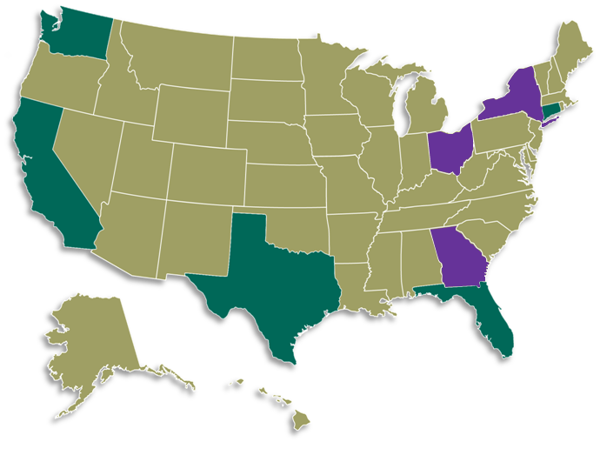

Solution: New Mathematics Pathways
Two 1-year pathways
1
Through college-level statistics
2
Through college-level quantitative reasoning

Slide 4
Carnegie Dev Math Pathways Initiative
Target: double the number of developmental math students moving to and through a college level math course by means of a one year sequence

Slide 5
What Makes These Pathways Different
Combining the worlds of research and practice
Focus on continuous improvement science
Building an ongoing networked improvement community focused on a high leverage problem: development math
Changed role of faculty

Slide 6
Changed Role of Faculty
Co-developers of materials
Research partners
Lesson study for curriculum and professional development
Continuous improvement in a networked community

Slide 7
It’s Not Just the Curriculum
Unique Pedagogy – focused on active student engagement
Productive persistence (student tenacity paired with good strategies)
Attention to Language and literacy

Slide 8
Statway and Quantway Learning Outcomes
Developmental Mathematics Learning Outcomes
Numeracy
Proportional Reasoning
Algebraic Reasoning
Functions

Slide 9
Statway – Statistics Learning Outcomes
Students will understand the data analysis process and the well-designed statistical studies
Students will demonstrate the use of distributional thinking to reason about data in order to describe trends and patterns, judge a fit of a model to distribution, and describe similarities and differences in comparing distributions.
Students will demonstrate an ability to use appropriate statistical evidence to reason about population characteristics an experimental treatment effects.

Slide 10
Quantway – Quantitative Literacy Outcomes
Students will demonstrate quantitative reasoning to analyze problems, critique arguments, and draw and justify conclusions.
Communicate quantitative results both in writing and orally using appropriate language, symbolism, data and graphs
Use technology appropriately as a tool
Exhibit confidence in quantitative reasoning through perseverance and ability to transfer prior knowledge in unfamiliar contexts

Slide 11
Lesson Share
Lesson 3.1.1 – Intro to Scatterplots and Bivariate Relationships
“The Cereal Lesson”

Slide 12
Productive Persistence =
Tenacity + Good Strategies

Slide 13
Fixed Mindset: “Being a 'math person' or not is something about you that you really can't change. Some people are good at math and other people aren't."

Slide 14
Productive Persistence: Scope of Work
Practical
Theory
Practical
Measures
Improvable “Starter Package”
Centered on a problem of practice
Co-developed with practitioners and students
Tested with academic experts
Brief and practical
Face-valid for practitioners
Recognizable to researchers
Designed to inform improvements
“Can’t improve what you can’t measure”
Initial set of activities
Systems for collecting data
Strategies for improvement
Field tests that inform practice and theories

Slide 15
Draft: Definitely incomplete, subject to continual revision.
Drivers of the problem
(things that keep us from meeting the aim)
Course content
Doesn’t “catch” interest
Successful Course Launch
(First 3-4 Weeks)
Classroom norms
“Doing math” and “Struggle” norms
AIM:
Students will be productively persisting at beginning of the fourth week of class
“Productive”
Social connections
To peers
PROCESS
MEASURES
% Correct
Logins
To math faculty
“Persistence”
Mindsets
Don’t see selves as math learners
Math anxiety

Slide 16
Productive Persistence Starter Package
Students’ Mindsets: “Undermine motivation”
Growth Mindset + Values Affirmation writing activity (mindset/stereotypes)
Setting the stage for productive struggle (classroom norms)
Why study statistics?/Why study mathematics? (relevance)
Social Connections: “Few or no connections; Unclear expectations”
Contract activity
Group work

Slide 17
Productive Persistence Questions
Interest: “Overall, how interesting are math and statistics to you?”
Fixed mindset: “Being a "math person" or not is something about you that you really can't change. Some people are good at math and other people aren’t.”
Anxiety: ”How anxious would you feel the moment before you got a math or statistics test back?”
Professors care: “How many of your college professors do you think would care whether you succeeded or failed in their classes?”
Belonging uncertainty: “When you think about your college, how often, if ever, do you wonder: "Maybe I don't belong here?"
Productive struggle: … “Knowing the right answer to a math problem without having to think about it, or knowing how to struggle with a math problem and discover the right answer?”

Slide 18
The Statway Data Speak…
ES = .28*
ES = .17*
ES = .10*
ES = Effect size
in SD units
* P < .001

Slide 19
Snapshot of Results Thus Far . . .
Ending enrollment compared to beginning enrollment: 84%
Based on data from 53 classes at 21reporting colleges as of January 17th, 2012
Pass rate
78% of STATWAY students received a grade of C or better
Based on data from 23 classes at 15 reporting colleges
Assessment results
Mean mid-term exam score: 62%
Based on goals set by 43 classes reporting, range 51% to 72%

Slide 20
What Statway Students Are Saying
“ I praise the fact that someone finally had enough sense to realize that a great deal of students have been kept from furthering their education due to this overpowering wall, and now there is hope for a lot of us, not only to pursue higher education but to learn something that would really apply to our everyday life. ”
Course relevance
“I panic a lot when I hear anything to do with testing”
“I feel that if one person put in the work to really understand the concepts they can pass. I was never a "math person" but coming into Statway has completely made a 360 degree turn about how I feel about math. It is great!”
Math and test anxiety
A growth mindset

Slide 21
How You Can Get Involved
Submit letter of interest with evidence of college’s culture of evidence, including:
demonstration of institutional research capacity and expertise;
evidence of the math department’s interest in committing to a common curriculum and assessments, and
focus on conceptual understanding, student engagement and language;
and an overall institutional commitment to continuous improvement
pathways@carnegiefoundation.org

Slide 22






Partners: Funding

Slide 23
Contact Carnegie
pathways@carnegiefoundation.org

